Slide 1
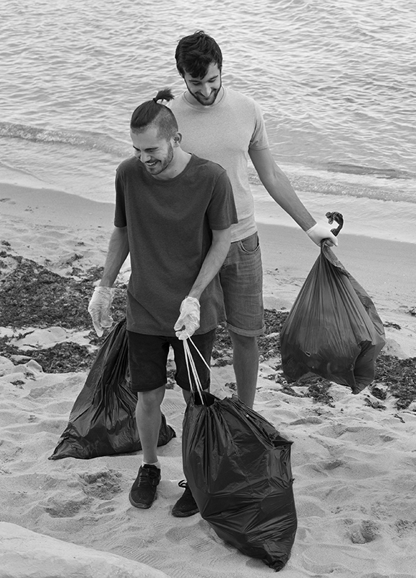
TrashIQ:
WASTE MANAGEMENT
SYSTEM
Navigating Waste, Empowering Change

Slide 2
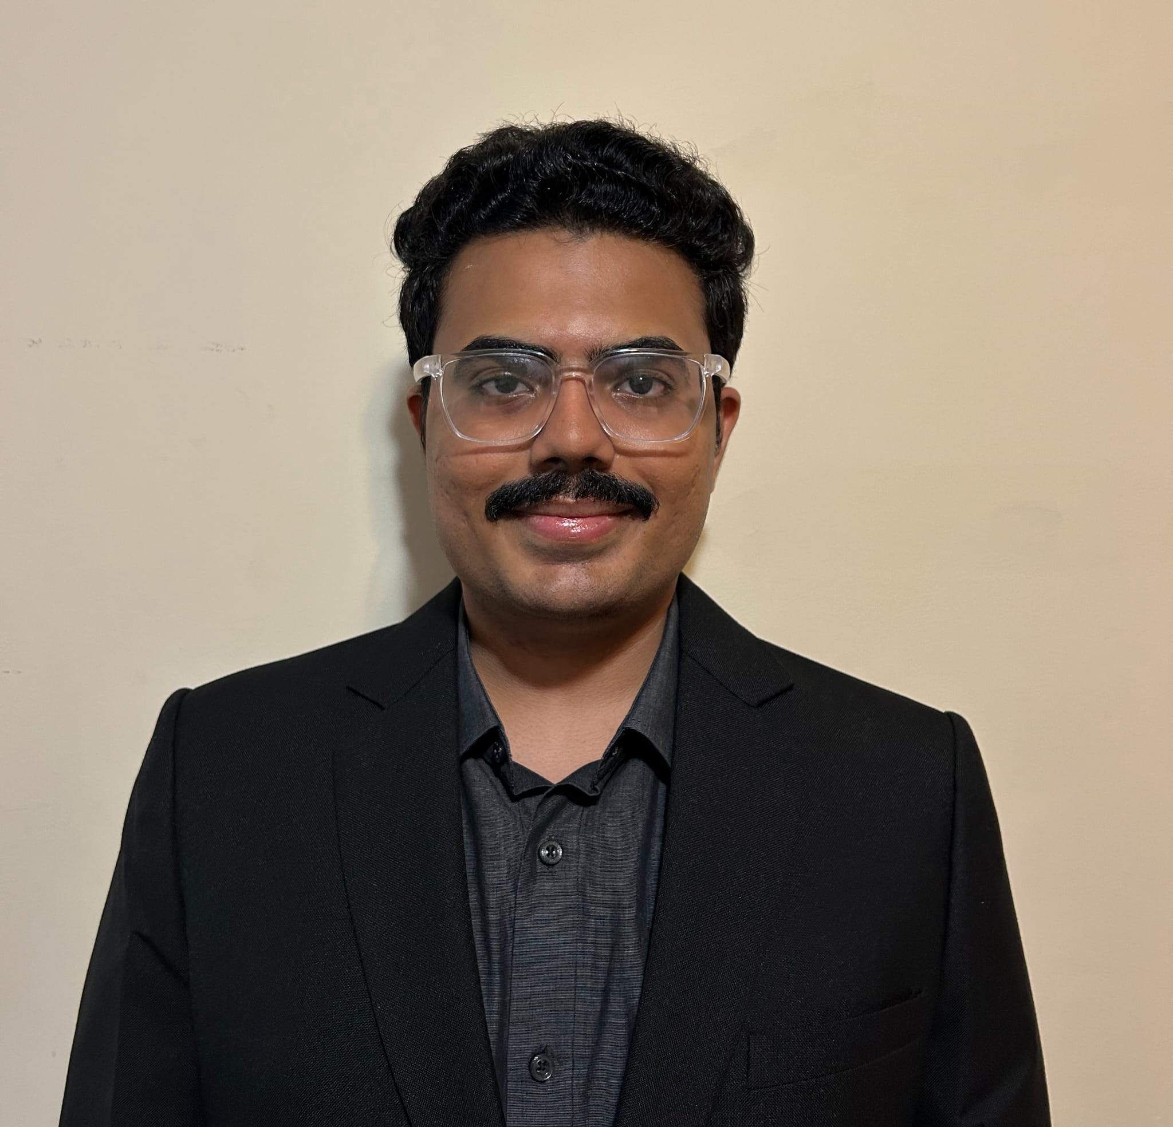
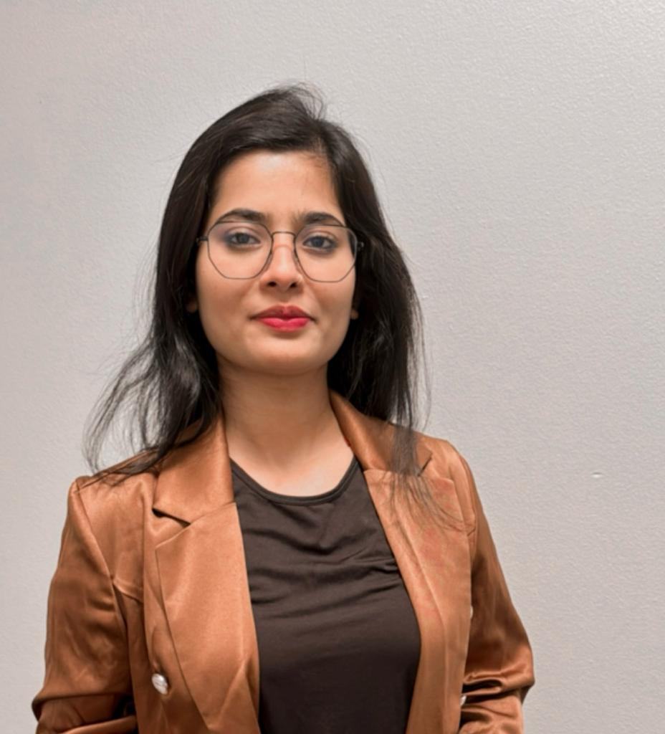

OUR TEAM
Chinmay Gulhane
Raveena Ingale
Prarthana Shetty
NUID: 002831871
NUID: 002837209
NUID: 002833314

Slide 3
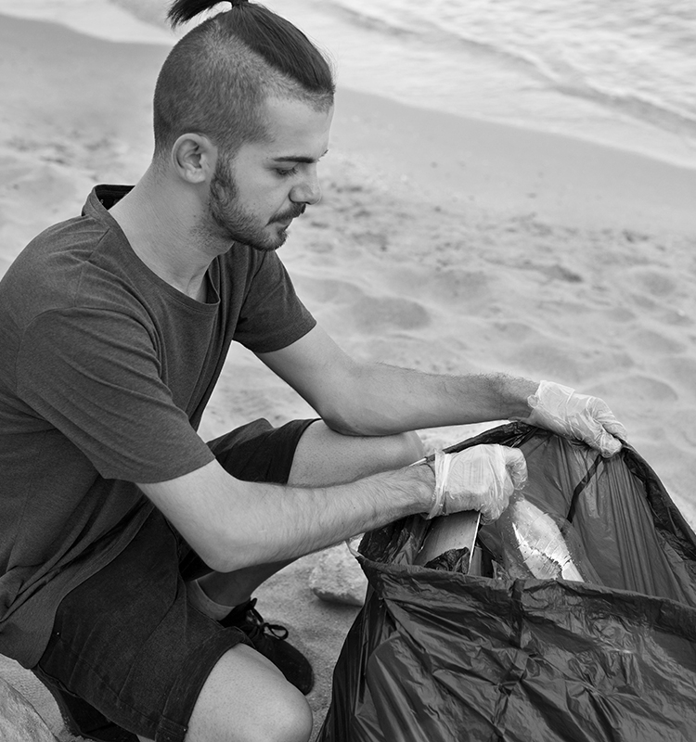
01
ABOUT THE
PROJECT
Our innovative project streamlines waste management from local neighbourhoods to counties and city levels, while concurrently establishing a marketplace to promote and sell high-quality recycled products

Slide 4
- ANNIE LEONARD, PROPONENT OF SUSTAINABILITY
“There is no such thing as ‘away’. When we throw something it must go somewhere.”

Slide 5

INTRODUCTION & APPROACH
Inspired by our professor Kal’s teachings on scalability and ecosystem-level projects, we crafted a comprehensive waste management initiative. This project seamlessly coordinates efforts from local counties to city levels and introduces a pioneering marketplace. This platform efficiently handles recycled products while fostering a sustainable hub for buyers and sellers dedicated to a greener future.

Slide 6
OUR ECO SYSTEM
WASTE MANAGEMENT
MARKETPLACE
Our innovative online trash disposal request application operates at different levels, from neighborhoods to counties to cities, managing waste as separate enterprises. Each level segregates and recycles, providing transparency on waste generation, fostering consciousness in buying habits.
The marketplace facilitates buying and selling of recycled products. All levels, from neighborhoods to cities, can participate, promoting a sustainable ecosystem where users actively engage in selling and buying recycled goods.

Slide 7
SYSTEM STRUCTURE
ENTERPRISES
ORGANIZATIONS
ROLES
We have 4 enterprises
We have 4 organizations
We have 6 roles

Slide 8
Enterprises
WASTE MANAGEMENT CORP
01
02
MUNICIPAL WASTE SERVICES
RETAIL WASTE ENTERPRISE
03
04
GREEN LIVING SOLUTION

Slide 9
OUR ORGANIZATIONS
Regional Waste Management
Municipal Waste Processing Org
Retail Waste Processing Org
Marketplace Org
Manages waste on County level
Manages waste on neighbourhood level
Manages waste of retail entities
Establishment where recycled items can be sold

Slide 10
ROLES
Waste Coordinator
Waste Collector
Waste Segregator
Marketplace
Integrator
PRINCIPAL USER
Retail User

Slide 11
PRINCIPAL USER WORKFLOW
USER
REQUEST
BUY
SELL
REQUEST HISTORY
MANAGE ORDERS
MANAGE PRODUCTS

Slide 12
RETAIL USER WORKFLOW
USER
REQUEST
MARKETPLACE
MARKETPLACE INTEGRATOR
REQUEST HISTORY
BUY
SELL
MANAGE ORDERS
MANAGE PRODUCTS

Slide 13
WASTE COORDINATOR WORKFLOW
USER
RAISE COLLECTION REQUEST
RAISE SEGREGATION REQUEST
MANAGE REQUESTS
PERFORMANCE INDICES
PROCESSING STATISTIC

Slide 14
WASTE COLLECTOR WORKFLOW
USER
MANAGE REQUEST
QUANTIFY WASTE

Slide 15
WASTE SEGREGATOR WORKFLOW
USER
MANAGE REQUEST
SEGREGATES WASTE

Slide 16
MARKET INTEGRATOR WORKFLOW
USER
WASTE CONVERSION
MANAGE PRODUCTS
VISIT MARKETPLACE
PUBLISH PRODUCTS
BUY
MANAGE
MANAGE ORDERS

Slide 17
WHOA!
The US produces an average of more than 1,700 pounds of food, plastic, and hazardous waste per person. At that rate, 5% of the world’s population generates 40% of the world’s waste.

Slide 18
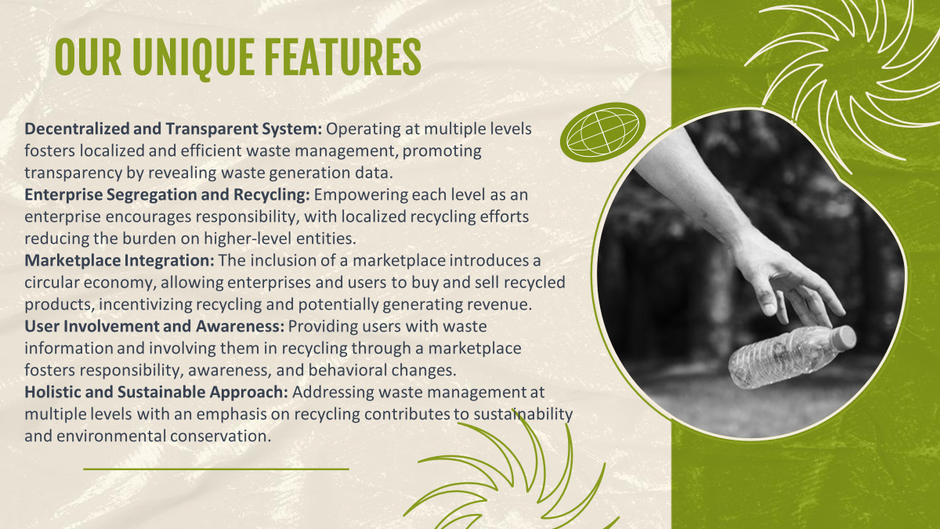
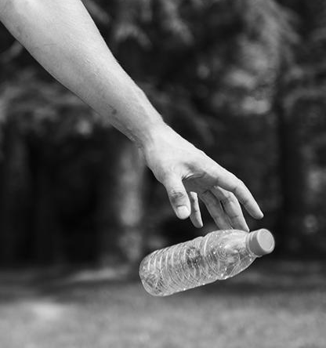
OUR UNIQUE FEATURES
Do you know what helps you make your point clear? Lists like this one:
They’re simple
You can organize your ideas clearly
You’ll never forget to buy milk!
And the most important thing: the audience won’t miss the point of your presentation

Slide 19
GREEN LIVING SOLUTION
Green Living Solutions Overview: Marketplace specializing in upcycled and recycled products. Partnership with the government for curated eco-friendly offerings.
Circular Economy Focus: Emphasis on reducing waste and promoting a circular economy.
Inclusive Platform:
Community Building: Fosters a community dedicated to sustainable living and innovation.
Empowering Small Businesses: Provides a platform for small businesses to thrive in the green market.
Conscious Consumerism: Encourages environmentally conscious purchasing decisions
RECYCLE
REVITALIZE
REINVENT

Slide 20
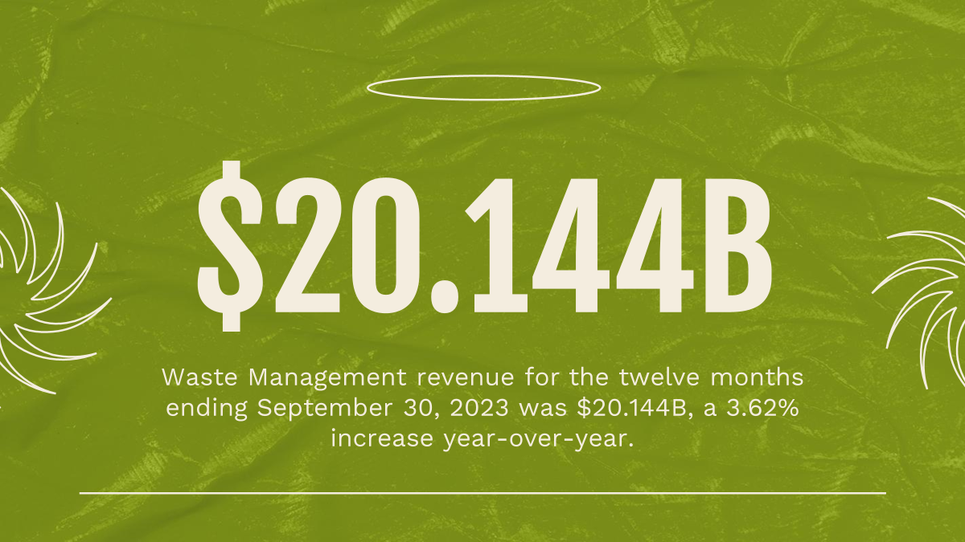
$150,000
Big numbers catch your audience’s attention

Slide 21
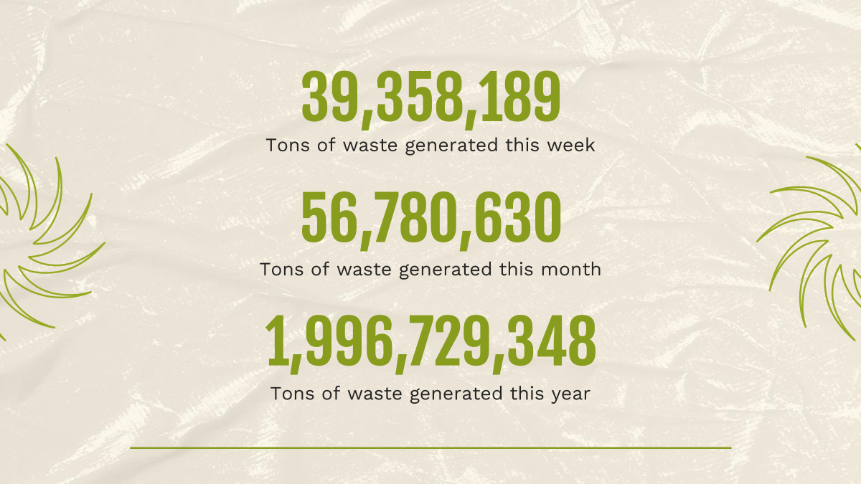
9h 55m 23s
333,000.000
386,000 km
Jupiter's rotation period
The Sun’s mass compared to Earth’s
Distance between Earth and the Moon

Slide 22

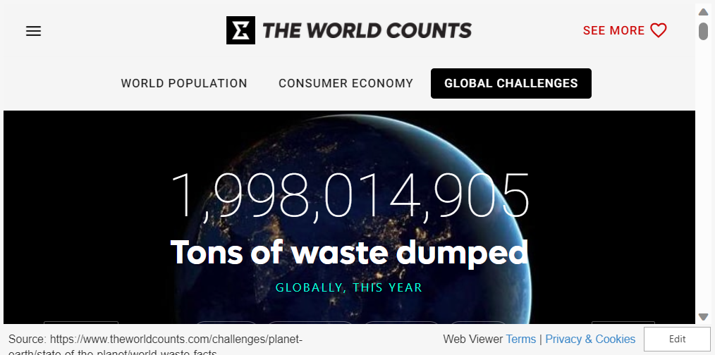
LIVE NUMBERS OF WASTE GENERATED AS WE SPEAK

Slide 23
LET’S LOOK AT OUR ORG CHART
ENTERPRISES
Waste Management Corp
Municipal Waste Services
Retail Waste Enterprise
Green living Solutions
ORGANIZATIONS
Regional Waste Management
Municiple Waste Processing Org
Retail Waste Processing Org
Marketplace Org
ROLES
Waste Coordinator
Waste Collector
Waste Segregator
Marketplace Integrator
Principal User
Retail User

Slide 24
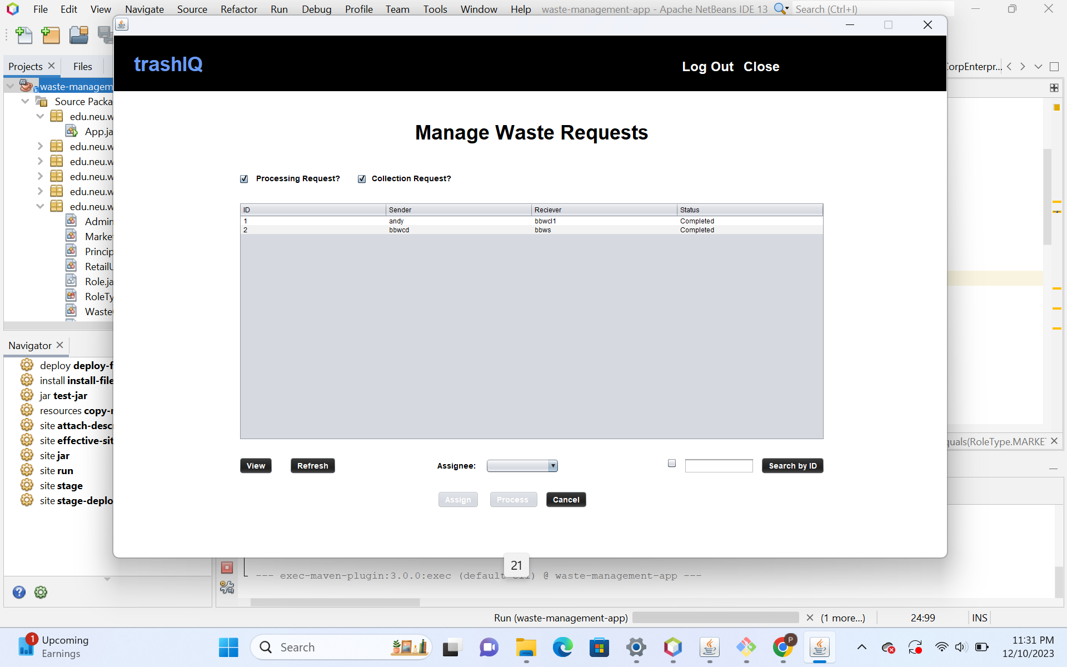
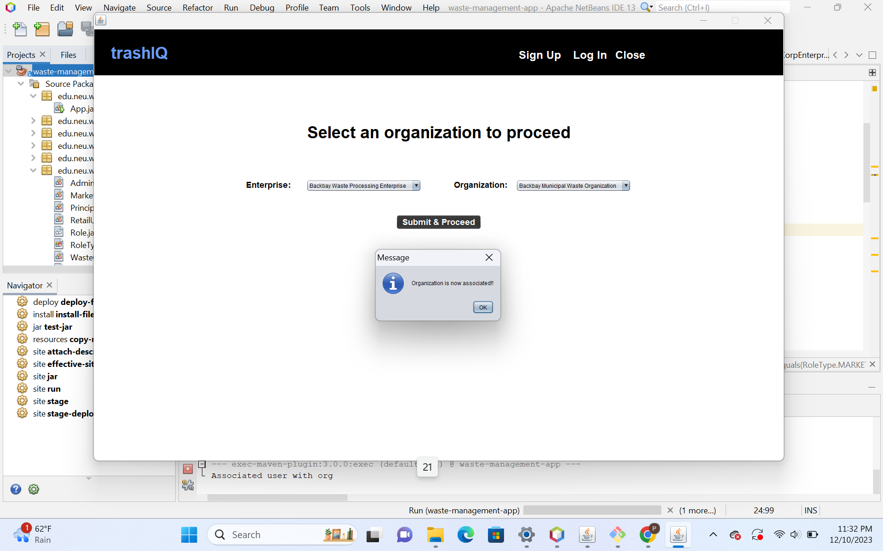
UI SCREENSHOTS

Slide 25
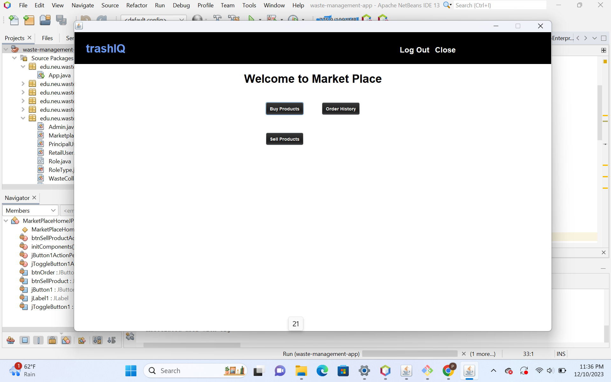
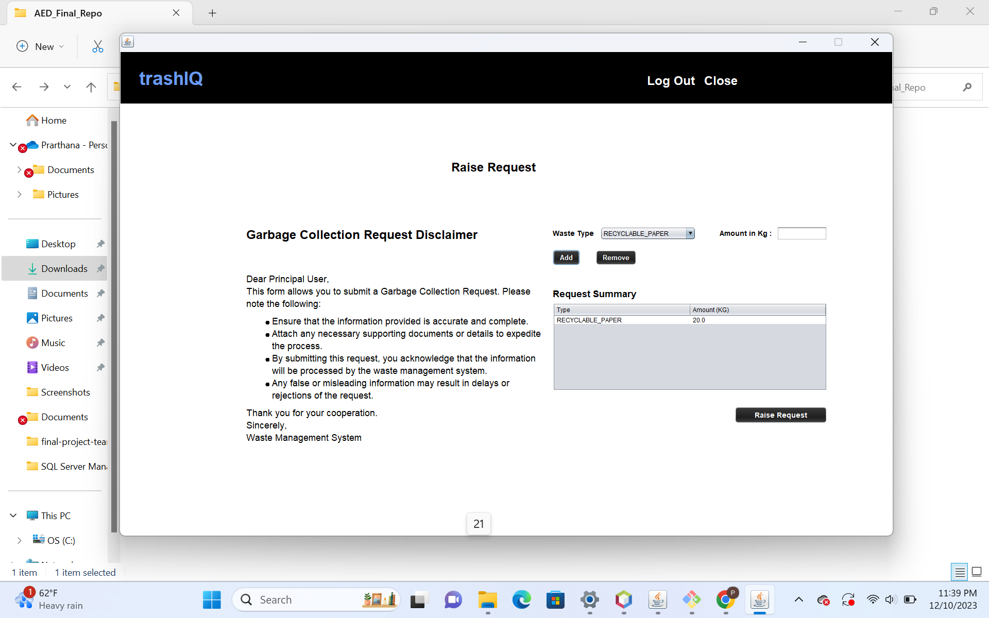
UI SCREENSHOTS

Slide 26
TRADITIONAL VS OUR APPROACH
Existing Methods: | OUR APPROACH:
Centralized Systems | Decentralized and Transparent System
Limited User Involvement | Enterprise Segregation & User Involvement
Linear Waste Management | Marketplace Integration
Individualistic and Exhaustible Approach | Holistic and Sustainable Approach
Texas, Louisiana, Mississippi, Ohio and Kansas generated nearly 80% percent of all the hazardous waste in the US

Slide 27
Let’s Compare USA’s Recycling Performance
76.6%
69.3%
59.7%
32.1%
SLOVENIA
GERMANY
SOUTH KOREA
UNITED STATES
The global leader
Second after
Slovenia
Third following
Germany
Way below
on the list on the 25th position

Slide 28
TOP CONTRIBUTORS TO GLOBAL WASTE GENERATION
NEW ZEALAND
CANADA
UNITED STATES

Slide 29
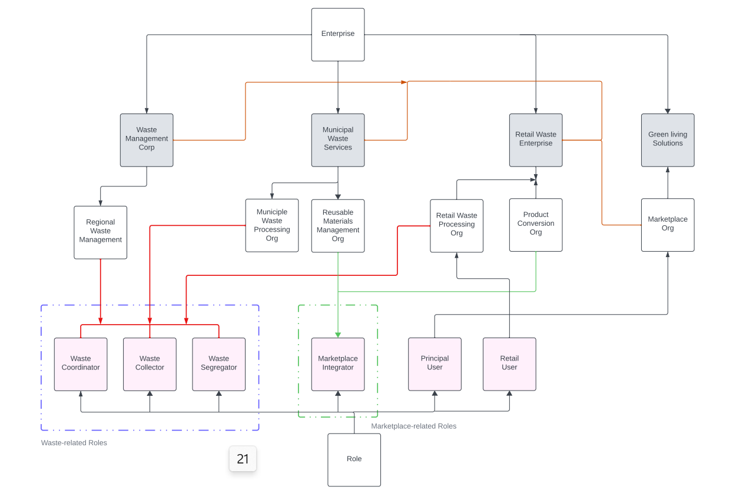
FUTURE SCOPE
Expand: We could add 2 more organizations Reusable Materials Management Org and Product Conversion Org expanding the hierarchy for product conversion and better product manufacturing incorporating more innovation.
Artificial Intelligence We could incorporate Artificial Intelligence for automation and Smart Waste Processing

Slide 30
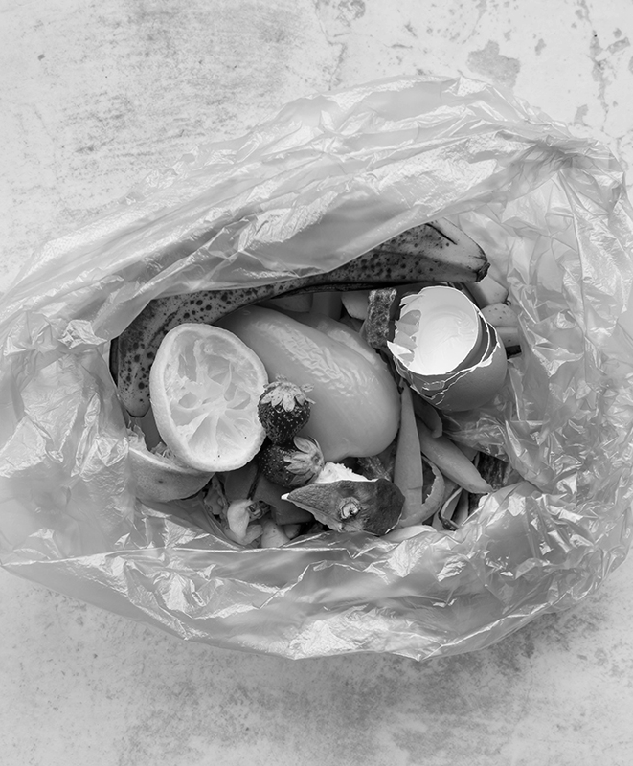
THANK
YOU
Do you have any questions?
gulhane.c@northeastern.edu | +1 (620) 421 838 ingale.r@northeastern.edu | +1 (617) 516-3067 shetty.prar@northeastern.edu | +1 (857) 961 7073
References: -LINK 1
-LINK 2
-LINK 3
-LINK 4
-LINK 5

